Slide 1




NEXT GEN EMPLOYABILITY PROGRAM
Creating a future-ready workforce
Team Members
College Name
Student Name :J.Raja
Student ID :au951221104035
JP College Of Engineering

Slide 2

CAPSTONE PROJECT SHOWCASE
Project Title
Voting Web Application using Django Framework
Abstract | Problem Statement | Project Overview | Proposed Solution | Technology Used | Modelling & Results | Conclusion

Slide 3
Abstract
"The abstract outlines the architecture and functionalities of the voting web application, including user authentication, ballot creation, voting process management, and result presentation. Security measures, such as encryption techniques and protection against common web vulnerabilities, are implemented to ensure the integrity and confidentiality of the voting process.
Source :

Slide 4
Problem Statement
1.Security : Implementing robust security measures to safeguard the integrity and confidentiality of the voting process, including encryption techniques, protection against common web vulnerabilities, and ensuring anonymity of voters.
2.Scalability: Designing the voting web application to handle a large volume of users and data efficiently, ensuring that it can scale to accommodate varying levels of traffic during peak voting periods.
3.User Authentication: Developing a reliable authentication system to verify the identity of voters and prevent unauthorized access to the voting platform, while also ensuring user privacy and data protection.
Source :

Slide 5
Project Overview
The project centers on developing a comprehensive web-based voting system leveraging Django framework. It will prioritize security protocols to guarantee the integrity and privacy of the voting process. Through intuitive interfaces, users will be able to create and manage ballots efficiently, while administrators will have tools for seamless voting process oversight. Results will be presented transparently, enhancing user confidence. The system aims to accommodate various voting scenarios with scalability and user-friendly design at its core.
Source :

Slide 6
Proposed Solution
.
1.Identity Verification and Registration Process
2.Survey Design and Administration
3.Ballot Casting and User Interaction
4.Live Feeds and Notification Services
5.Openness and Verifiability in Procedures
6.Enhanced Scalability and Performance Tuning
7.Data Insights and Analytics Reporting
8.Regulatory Compliance and Cybersecurity
Source :

Slide 7
Advantages:
1.ORM (Object-Relational Mapping): Django's ORM simplifies database interactions by abstracting away SQL queries, allowing developers to work with database models using Python syntax, thus reducing development complexity and potential errors.
2.Template Engine: Django's template engine enables the separation of logic and presentation, facilitating the creation of dynamic and responsive user interfaces for the voting application.
3.Built-in Admin Panel: Django's built-in admin panel offers a user-friendly interface for managing application data, including users, polls, and voting results, without the need for additional development effort.
4.RESTful APIs: Django REST Framework (DRF) provides powerful tools for building RESTful APIs, enabling integration with external systems, mobile apps, and other web services, enhancing the accessibility and interoperability of the voting application.
Source :

Slide 8
Disadvantages:
1.Learning Curve: Django has a steep learning curve, especially for beginners with limited experience in web development or Python programming. Its extensive features and conventions may require time and effort to grasp fully.
2.Overhead: Django's comprehensive nature and bundled features can result in some overhead, especially for small or simple projects where all of its functionalities may not be necessary, potentially impacting performance and resource usage.
3. Flexibility vs. Convention: While Django promotes best practices and conventions for web development, its opinionated nature may limit flexibility for developers who prefer more freedom in choosing libraries, frameworks, or architectural patterns.
4. Monolithic Architecture: Django follows a monolithic architecture, which means that all components of the application (e.g., ORM, views, templates) are tightly integrated within the framework. This can make it challenging to decouple and scale individual components independently.
Source :

Slide 9
Technology Used
Front-end
Back-end
HTML
PYTHON
CSS
DJANGO
JAVASCRIPT
SQL
BOOTSTRAP
Source :

Slide 10
Modelling & Results
Modeling Efficiency and Result Accuracy: The efficacy of the voting system's data modeling directly influences its performance and accuracy. By optimizing data structures and query operations, potential bottlenecks can be mitigated, ensuring swift access to information and precise calculation of voting outcomes. Rigorous testing methodologies and validation protocols further enhance result accuracy, maintaining the system's integrity and fostering trust among users.
Source :

Slide 11
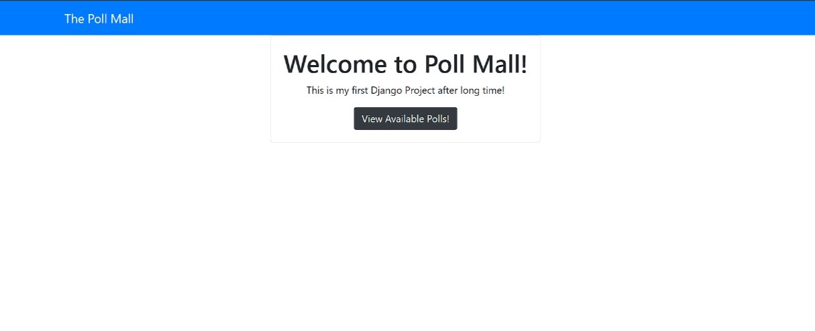
Homepage

Slide 12
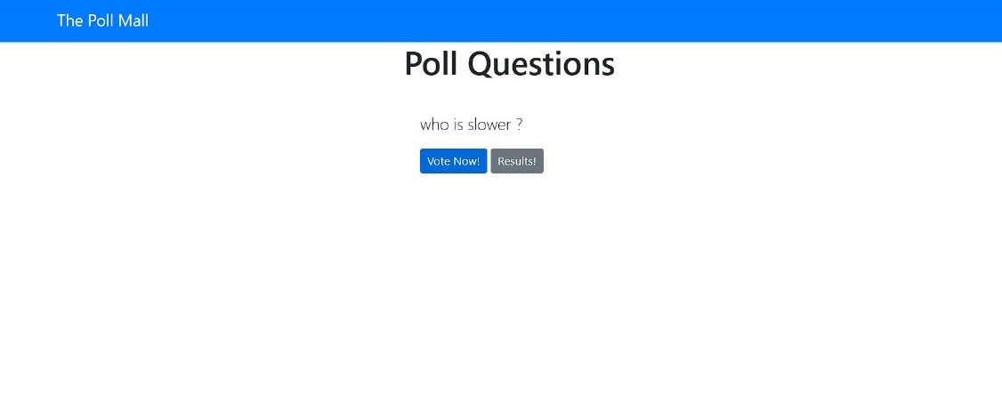
Polling page

Slide 13
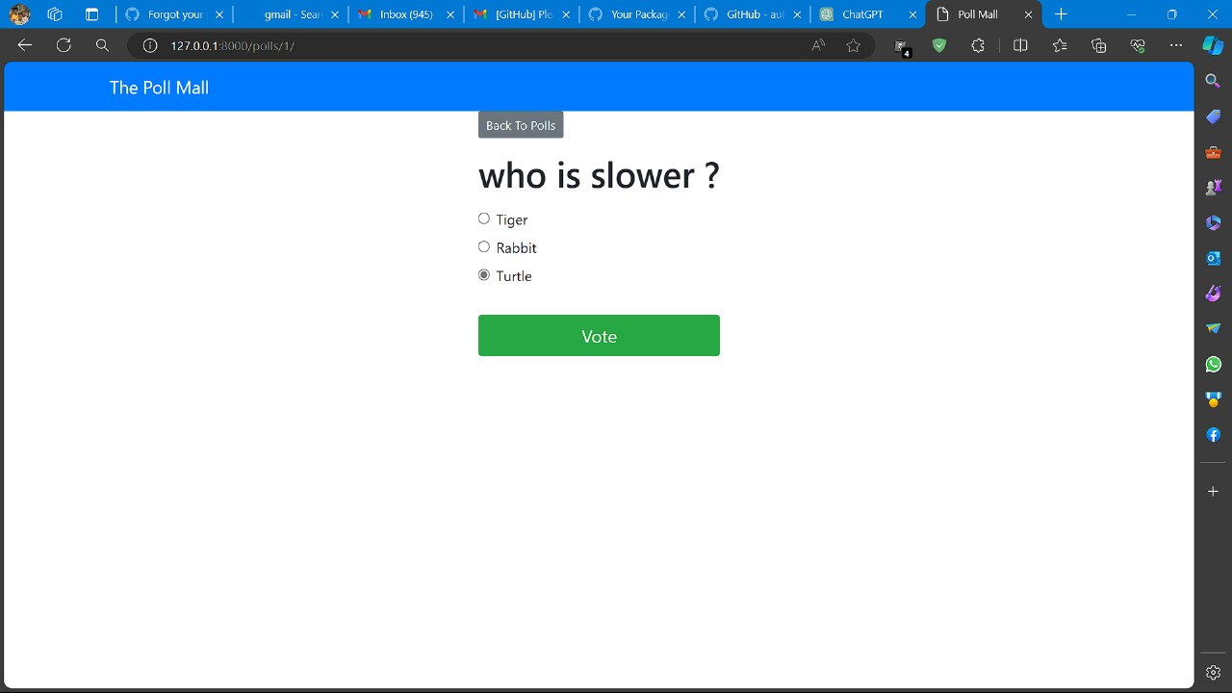
Voting page

Slide 14
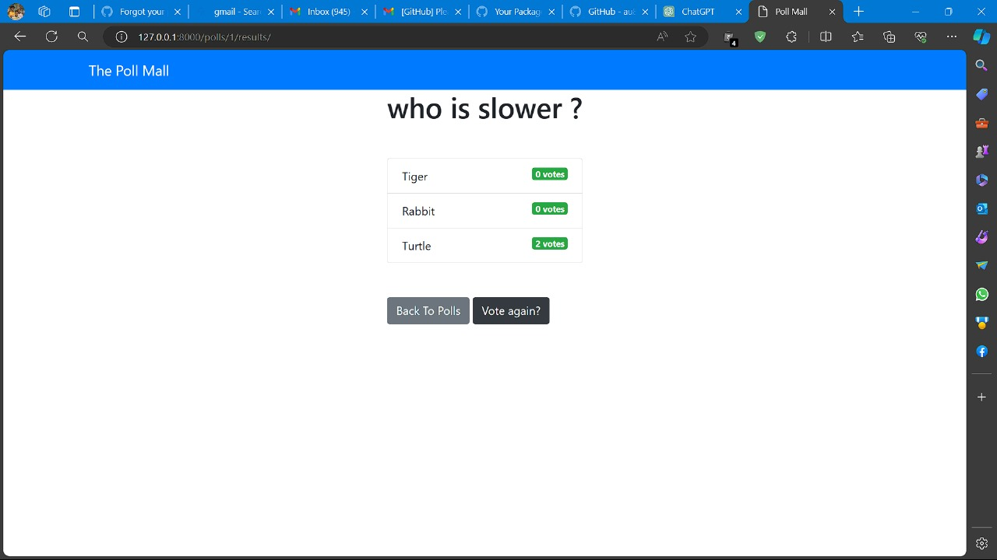
Admin page

Slide 15
Future Enhancements:
. Potential future enhancements include the integration of machine learning algorithms for predictive analysis of voting trends, development of mobile applications for increased accessibility, implementation of blockchain technology for enhanced security and transparency, incorporation of multi-factor authentication methods for heightened user verification, expansion of reporting capabilities for more comprehensive data insights, and exploration of decentralized voting mechanisms for greater democratization of the voting process.

Slide 16
Conclusion
In summary, leveraging Django Framework for a Voting Web Application presents a promising avenue for creating a secure, user-friendly, and scalable voting platform. While challenges like the learning curve and potential overhead exist, Django's rich feature set and active community support offer robust solutions. With a focus on continual improvement, future enhancements could include integrating advanced security measures, expanding accessibility through mobile applications, and refining data analytics for more insightful reporting. By prioritizing transparency, integrity, and user experience, Django-powered voting systems have the potential to significantly impact democratic processes positively.
Source :

Slide 17
Thank You!
Notes:
Thank You !!

